Slide 1
Problem Statement
Automation in HR Ops: Automating HR On boarding and Communication Workflows :
Current State at LTC: HR Operations including (BGV, on boarding, payroll, and communication), and currently rely heavily on manual and repetitive tasks. These include:
Extracting new joiner data
Generating GIDs
Sending appointment letters and on boarding emails
Managing document submissions
Such processes are time-consuming, error-prone, and lack scalability.
Proposed Solution: Integrated Automation System : A comprehensive system that can:
✅ Extract and validate employee data from Excel files and documents
🧾 Auto-generate GIDs and appointment letters using standardized formats
📧 Automate personalized email communication throughout on boarding stages
📥 Monitor inboxes, track document submissions, and update vetting statuses
🛡 Ensure secure archiving and compliance with document handling protocols

Slide 2
Solution
High-Level Solution Design for Smart On board
1. Creativity – Originality and Artistic Innovation
AI-Driven Automation: Uses cutting-edge AI for document validation, email monitoring, and contextual communication to reduce manual tasks and foster innovation.
Event-Driven Workflow Engine: Triggers real-time actions based on dynamic rules (e.g., document submission, BGV completion).
Human-in-the-Loop Integration: Combines AI with human review to ensure reliability and empathy in complex cases.
2. Design Quality – Seamless Design and Technology for an Exceptional Experience
Modular Micro services Architecture: Each function (e.g., email monitoring, document validation, BGV tracking) is built as an independent, reusable module.
API-First Design: Enables integration with platforms like Workday, background verification services, and email systems.
Responsive UI/UX: Designed with frameworks like React or Angular for a smooth experience across devices.
3. User Experience – Ease of Use and User Engagement
Candidate Portal: Personalized dashboard for candidates to upload documents, track progress, and stay informed.
HR Dashboard: Centralized control panel for HR teams to monitor on boarding, make interventions, and configure workflows.
Smart Notifications: Context-aware alerts via email, SMS, or in-app messaging to keep users engaged and up to date.
4. Scalability and Maintainability – Future-Proof and Easy to Manage
Cloud-Native Deployment: Hosted on scalable cloud infrastructure (e.g., AWS, Azure, GCP) with auto-scaling and high availability.
CI/CD Pipeline: Automated testing, deployment, and rollback mechanisms ensure rapid and safe delivery of updates.
Configuration-Driven Workflows: Business rules and workflows are defined via configuration files or admin UI, allowing non-technical users to adapt the system without code changes.
5. Functionality & Extendibility – Practical, Usable, and Expandable
Core Functional Modules: ▪ AI Document Validator ▪ Email Listener & Parser ▪ Workflow Engine ▪ Communication Generator ▪ BGV Tracker ▪ Workday Integration (GID creation)
Extensibility Hooks: Plugin-based architecture allows easy addition of new modules (e.g., integration with other HRMS, additional verification services).
Audit & Compliance Layer: Tracks all actions and decisions for transparency and regulatory compliance.

Slide 3

Interview process
selected
No
Communication Feedback
Archive Information
Stop
Uploads selected candidates Excel
Yes
This is Our Project Scope
On-BoardPro UI
Data Consent & Preliminary doc collection
Document validation By AI Agent
Candidate Offer Letter
Yes
Accepted
No
Accepted
No
Renegotiate/correction
Archive Information
Stop
Yes
Initiate BGV
Success
No
Communication Feedback
Archive Information
Stop
Yes
Joining follow-up &date conformation
Yes
Is Joining
No
Want’s to Join Another Day
Archive Information
Stop
Yes
Generate GID
Joined
No
Archive Information
Stop
Yes
Stop

Slide 4
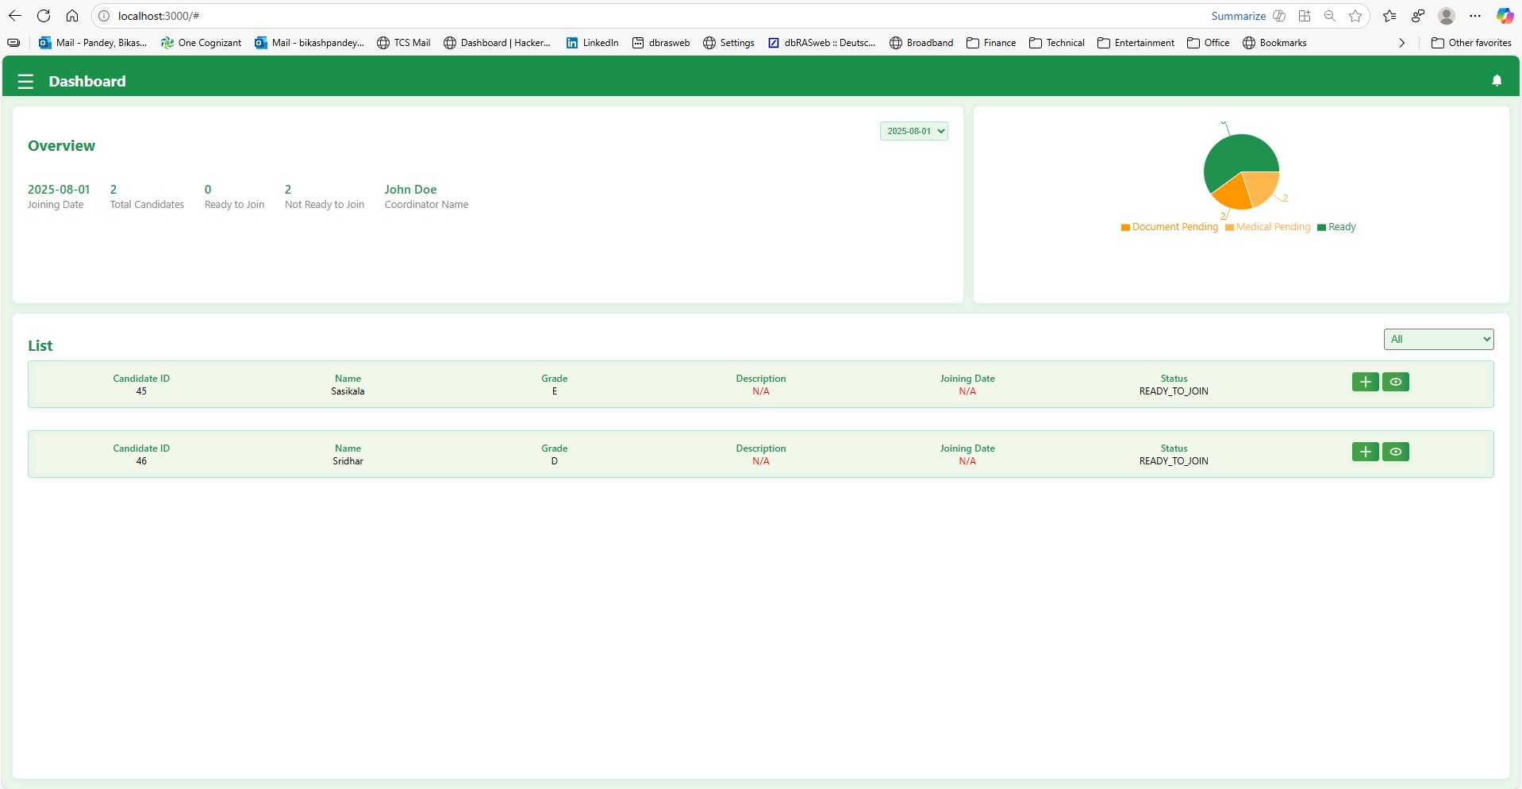
Screenshot

Slide 5
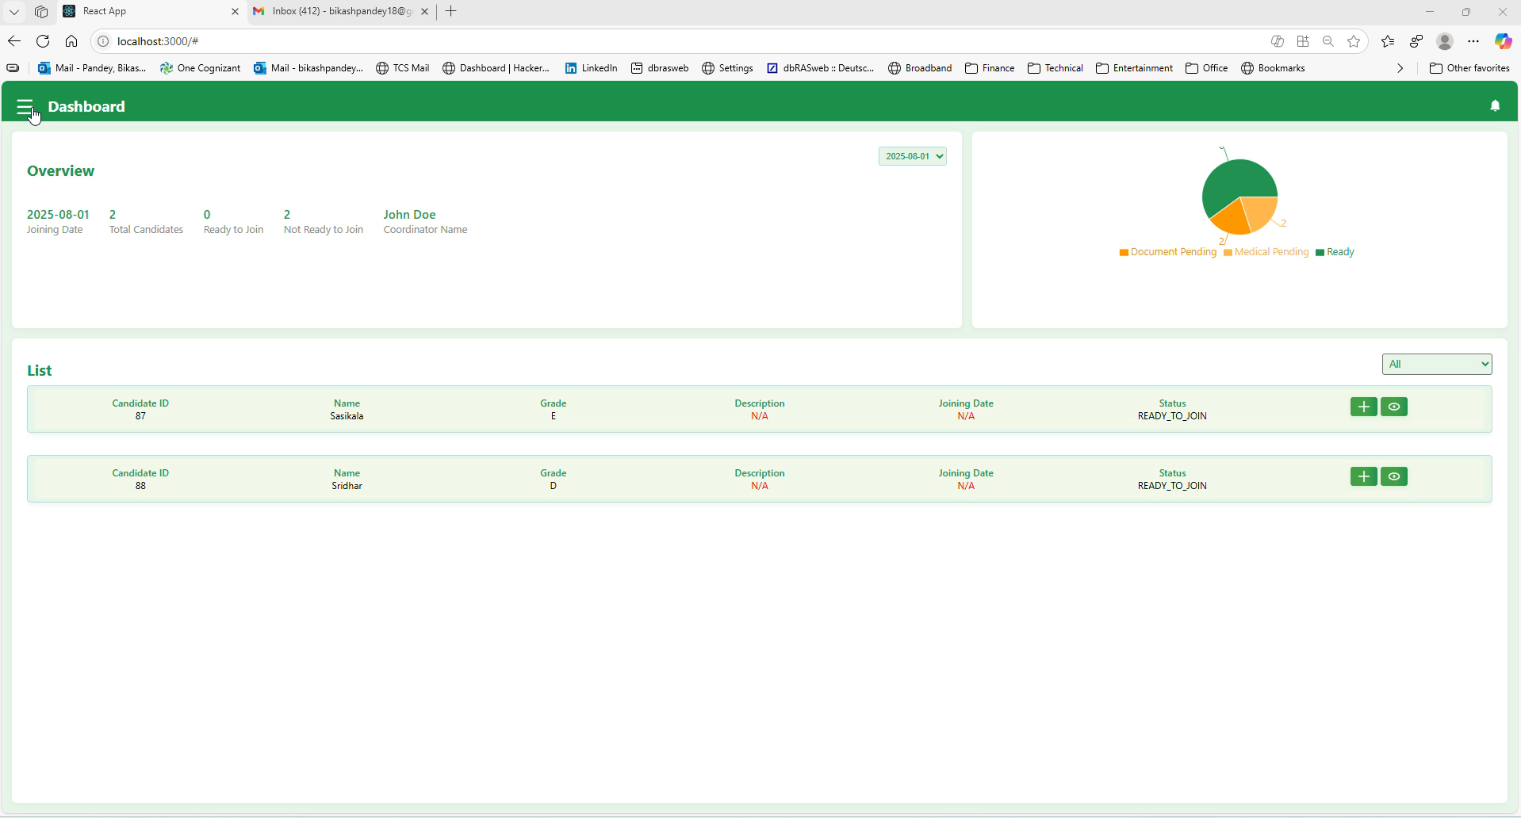
Demo -1(Offer Release)

Slide 6
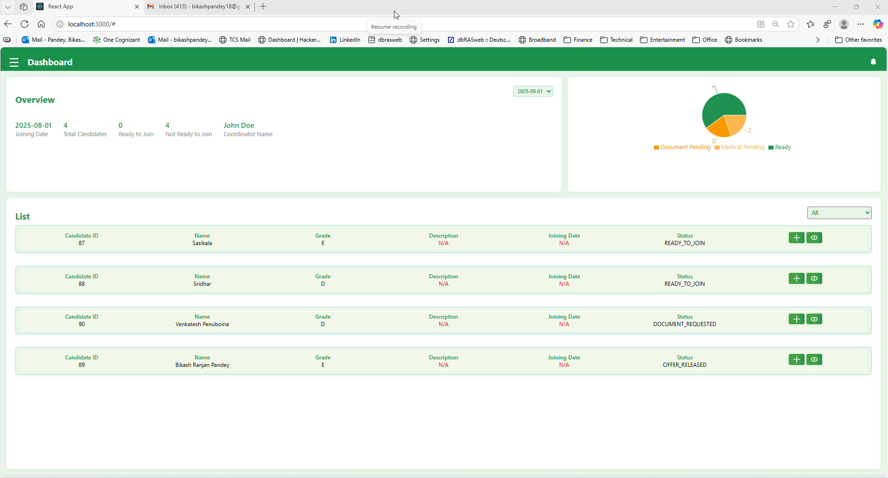
Demo -2(Offer Declined)

Slide 7


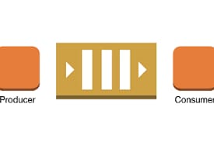


ARCHITECTURE
Communication Service
Auth Service
Pub/Sub
Doc Storage
HR AI Service (AI Agent)
Dashboard Service
Workflow Manager
HRBPM UI
WORKDAY
Vector DB
DB

Slide 8
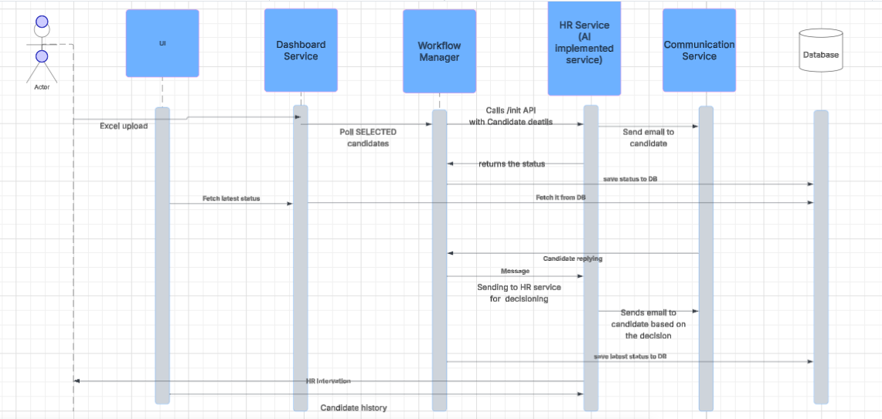
Sequence Diagram

Slide 9
Future scope
1. Integrate with workday, HireRight for BGV.
2. AI interview process.
2. Document archive.
3. Preliminary doc verification using Layout LM for visual verification.
4. Guardrails while using LLMs(Confidential Info).
5. Token handling using SLM & LLM.

Slide 10
